Slide 1

Lecturer Claim Automation System
ST10442580
ST10442580
PROG6121 Final POE

Slide 2

Contents
Title and Profession
Design and Architecture
functionality
Automation and Conclusion
Introduction to slide
All the designs and Understanding of MVC Pattern and Separation of Concerns (Service Layer).
Calculation Logic,User Views/Tracking,
For more info:
SLIDESGO | SLIDESGO AI TOOLS | BLOG | FAQs
You can edit the master slides easily. For more info, click here
You can visit our sister projects:
FREEPIK AI TOOLS | FREEPIK LIBRARY RESOURCES
You can delete this slide when you’re done editing the presentation

Slide 3
Slide 1:
I am presenting my Portfolio of Evidence for
the Lecturer Claim Automation System (L-CAS), a web application built for PROG6121.
This system was designed to replace a manual, paper-based process, transforming it into a secure, automated digital workflow."
"My presentation will focus on the architectural decisions, the implementation of the core Functional Requirements (F1-F4), and crucially, the Process Automation (P3) features I developed.

Slide 4
Slide 2: Design
"The foundation of L-CAS is the ASP.NET Core MVC pattern, using C# and Entity Framework Core for data management."
"The key design decision was enforcing Separation of Concerns. We have the Controller to handle traffic, and the Database for persistence."
"But critically, the Service Layer is where all the POE requirements are fulfilled. It executes F1, F2, and P3 logic. This isolation makes the system maintainable and highly testable."
"(Referencing the Diagram): This diagram shows the clean flow: The Controller delegates business tasks to the Service Layer, which then interacts with the database."

Slide 5
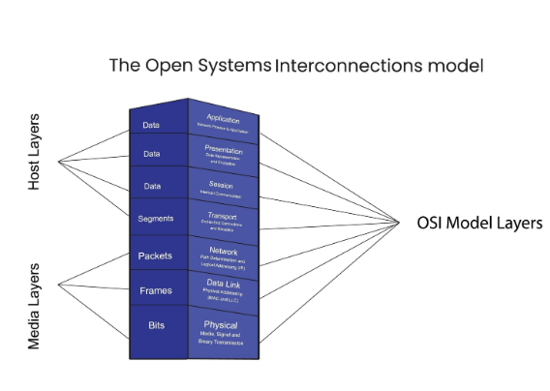
Slide 2:Design -image:

Slide 6
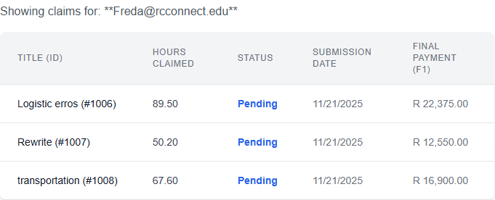
Slide 3:Functional Requirements:
Starting with basic requirements, F3 is the Claim Submission form. This form uses Data Annotations to ensure data validation, such as checking for valid emails and requiring all fields."
"Once submitted, the lecturer needs to track the claim (F4). The system ensures strict security by filtering the list to show only the claims associated with the lecturer's email.

Slide 7
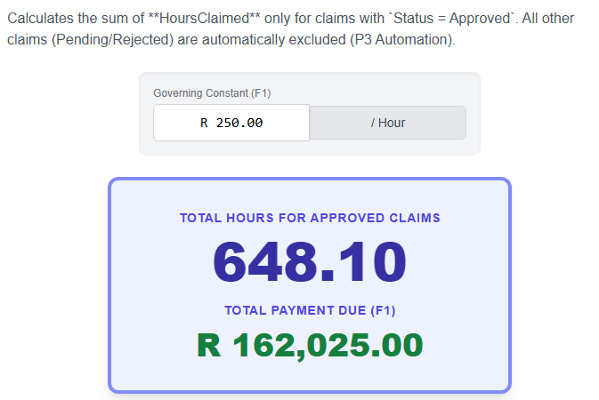
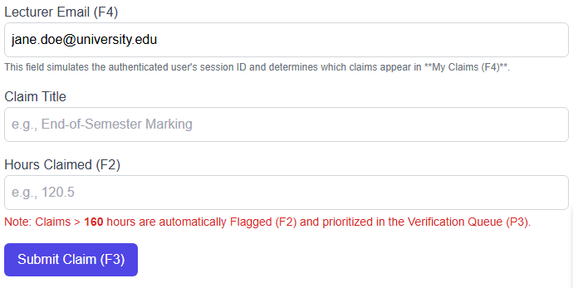
Slide 4: Functional Requirements:
Automatic Calculation is simple: the Service Layer calculates the Final Payment Amount by multiplying the hours claimed by the standard hourly rate before the claim is saved. No manual calculation is needed."
"F2 (Manager Flagging) is our initial risk control. If a claim exceeds 160 hours, the Service Layer automatically sets a RequiresManagerFlag to true. This proactively highlights claims that may indicate fraud or budget issues.

Slide 8
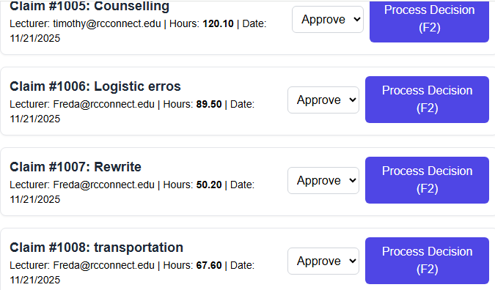
Slide 5: Automation:
This is the first part of P3 Automation—making the Coordinator's job efficient. Instead of reviewing claims randomly, the system implements a Priority Queue.
"The sorting logic is two-tiered: 1. High-Risk claims (Flagged) are always moved to the top of the queue. 2. Within that group, we use FIFO (First-In, First-Out) based on the submission date.

Slide 9
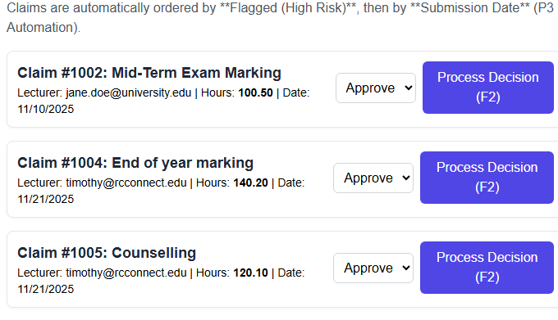
Slide 6: Payroll
The second part of P3 is the Payroll Report. Its core function is financial security."
"The system aggregates the total hours only for claims that have {Status} = {Approved}. All Pending or Rejected claims are automatically excluded from the final payment total.

Slide 10
Conclusion:
In summary, L-CAS successfully integrates all required functional (F1-F4) and process automation (P3) requirements, delivering a tested, robust solution."
"Looking forward, the next critical step would be implementing ASP.NET Identity to manage secure user roles (Lecturer vs. Coordinator) and adding an Audit Trail to track exactly who is approved.

